Slide 1



SHOP APP
BY Anusha Mandepudi Arun Chary Gattoji Bhuvaneswar Reddy Kunduru Suprith Son Dubba

Slide 2
Teams and Contributions​
We worked as a group of two for the development of each functionality
Team 1: Arun & Suprith ​ Focus: Shopping Cart Development​ Contributions: Collaborated on designing and implementing a user-friendly and efficient shopping cart feature for a seamless shopping experience.​
Team 2: Anusha & Bhuvaneshwar Focus: User Account Features​ Contributions: Worked together on the development of user account functionalities, including the login and signup pages, enhancing user experience and security.​
Team 3: Anusha, Suprith & Arun Focus: Admin Panel Development​ Contributions: Jointly developed the Admin Panel, focusing on robust management tools for product and order handling.​
Team 4: Arun, Bhuvaneshwar & Suprith Focus: Product & Orders Screens, Firebase Integration​ Contributions: Partnered to design the product and orders screens for the admin side and integrated Firebase for reliable database management.​

Slide 3
Project Overview
Our Vision​ At the heart of the Shop App is our vision to transform online shopping. We aim to make e-commerce simpler, faster, and more innovative, redefining the way customers buy commodities through the internet.
Key Features and Technology​ Our app boasts a responsive, well-defined front end built using React JS, offering a smooth browsing experience. Key features include product browsing, a shopping cart, an admin panel and a hassle-free purchasing process."​"Backed by Firebase, our robust backend framework ensures secure data management, real-time updates, and scalability to meet the growing needs of our users.
The Shop App Experience​ Combining these cutting-edge technologies, the Shop App creates an experience that is not only dependable and quick but also enjoyable. We're setting a new standard for online shopping, focusing on reliability, user satisfaction, and continuous innovation.

Slide 4

Admin
Product Management
Add New Products:
Easily add new products to your catalog. Include essential details: Name, Price, and Image.
Edit Existing Products
Update information for any product. Modify details like price and image as needed.
Delete Products
Remove products from the store quickly. Maintain an up-to-date product list for your customers.

Slide 5

Admin
Order and Customer Management
View Orders
See a comprehensive list of all user orders.
Details include Customer Name, Address,Email, Order Total,Date and Price.
Access and manage customer accounts.
Delete Orders
Delete the customer orders from the list to keep an up to date of orders list .

Slide 6

User
Product Browsing and Shopping Cart
Product Browsing
Categories: Effortlessly browse through a variety of product categories.
Product Details: View product information, below each product with an image and price .
Shopping Cart
Add to Cart: Easily add your favorite products to the shopping cart.
Edit Cart Contents: Adjust quantities or remove items as needed.

Slide 7

User
Checkout and Account Management
Checkout Process
Shipping Details: Easy checkout with the existing information given during the signup.
Order Management
Order History: Review your orders easily with information including product name price, quantity and date of order.

Slide 8

Demonstration
Let's take a closer look at our fully functional application and experience the seamless shopping journey it offers. It's time to shop with ease and simplicity!

Slide 9
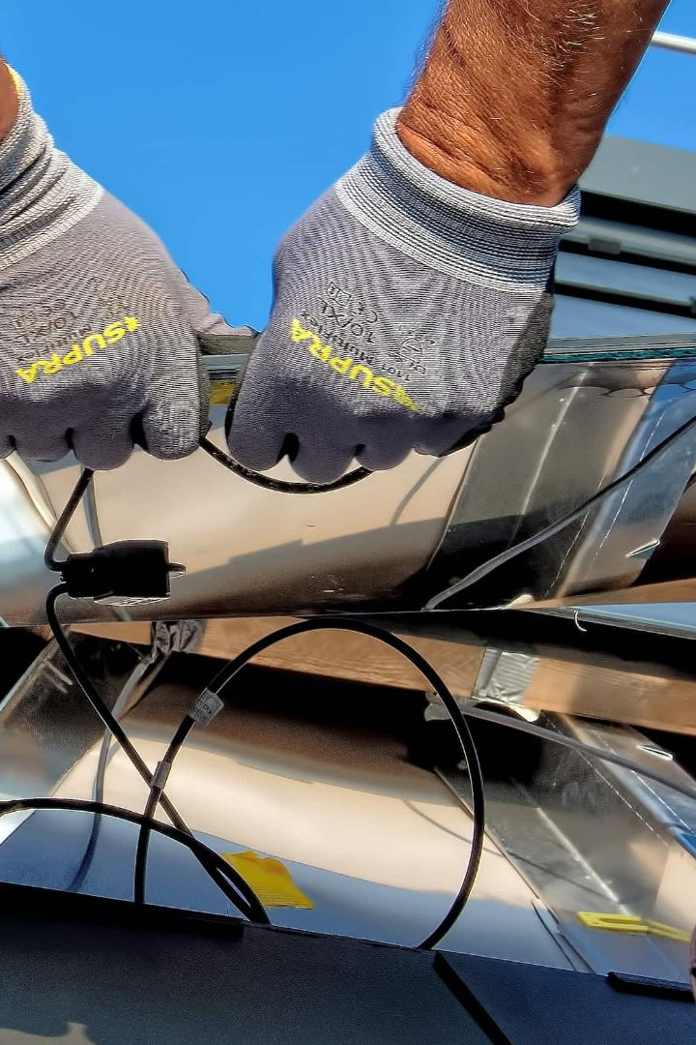
Installation
After downloading the code from github, run NPM INSTALL in the terminal to install all dependencies. Then, run NPM START to launch the application. It's as easy as that!

Slide 10
Design to Development
State at Midterm
At our midterm presentation, we were in the thick of designing the user interface (UI) of the Shop App. Our focus was on crafting a visually appealing and intuitive design that would enhance user experience."
Advancements Made
Since then, we've made significant strides. Not only have we completed the UI design, but we've also successfully developed all the planned features of the app.
Key Developments
UI to Functionality: Transitioned from UI design to functional implementation, bringing the interface to life.
Feature Completion: Developed and integrated essential features such as the shopping cart, user accounts, admin panel, and product & order management.
Testing and Refinement: Conducted thorough testing to ensure functionality and user experience, making necessary refinements for optimal performance.

Slide 11

Project Timeline and Adaptability
Adapting to Unforeseen Circumstances • Our project journey encountered an unexpected turn when health issues affected couple of our team members. Prioritizing their well-being, we extended our timeline by 2 weeks. Team Response and Adaptability • This situation called for flexibility and teamwork. We redistributed tasks, focused on critical features, and supported each other to stay on track with the revised schedule. Emerging Stronger • These challenges taught us valuable lessons in adaptability and collaboration. Despite the delay, we successfully achieved our project goals, demonstrating our commitment to quality and team health.

Slide 12

Conclusion
This Shop app provides a comprehensive solution for online shopping, with robust features for both admin and user interfaces. The use of ReactJS ensures a dynamic and responsive front-end, while Firebase provides a secure and scalable backend. The admin side focuses on complete management of products, orders, and analytics, while the user side offers a seamless shopping experience with features like browsing and cart management.

Slide 13


